Slide 1
THE HUMAN REPRODUCTION SYSTEM
Name
Institution
Date

Slide 2
Introduction
The human reproduction system is a system of multiple organs,which aids in live offspring production.
The human reproduction system can be classified into two categorized, which comprises of the male and female reproduction system.
Both the male and female reproduction system serves a crucial purpose in the process of procreation.
The male and female reproduction system have difference structures serving distinct functions in the process of reproduction.
Not only kids must comprehend the overall process of reproduction but also they should be acknowledged safe sex.
Notes:
Several reproduction organs for both male and female plays important roles in the process of procreation . Parents must take a key role in ensuring their kids learn about human reproduction system to ensure that ,they grow acknowledging the system. In addition, parents have an obligation of introduce the concept of save sex to prevent earlier pregnancies as well as STDs among the youth.

Slide 3
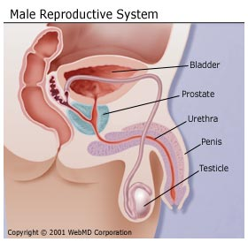
Male Reproduction System
Structure
Notes:
The male reproductive system organs are located outside and inside the pelvis as shown in the above diagram. The fact that the male genitals are located inside and outside the pelvis differentiate them from female reproductive organs which a entirely located within the pelvis. The male reproductive organs functionality starts from nervous stimulation, implying that the nervous system is a vital system for reproduction organs.

Slide 4
Male Production Organs and their Functions
Penis-comprises of two parts: the glans and shaft. Penis serves as the only pathway for semen exit in male reproductive system during sex.
Testicles-they assume oval shape structure ,testicles functions are to produce and store sperms in male reproduction system.
Scrotum-houses testicles ,nerves and blood vessels. It regulate temperature within the testicles.
Urethra- Its tube that helps in ejaculating semen in the state of organism in a man, however, urethra has a duty of carrying urine away from the bladder.
Prostate gland-its located below the bladder, its function is to nourish the sperm since it produces fluid for ejaculation.
Notes:
Every organ in male reproduction system assume different shape ,which serves as its adaptation to their specific function. The location of the organs, in or out of the body also has a significant purpose as stated above.

Slide 5
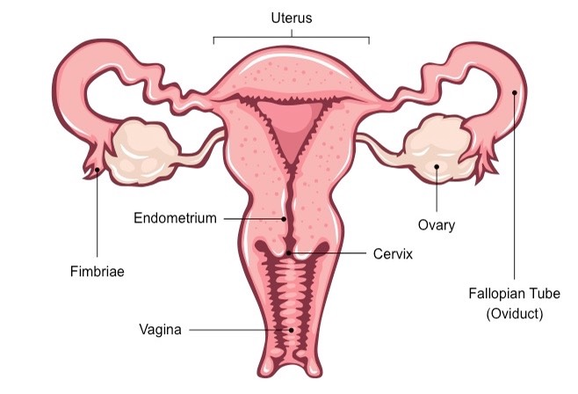
Female Reproduction System structure
Notes:
Female reproduction organs are entirely found inside the pelvis making them adaptable to reproduction. The mode formulation of every organ in the female reproduction system makes it more adaptable to their role in the process of reproduction.

Slide 6
Female Reproduction Organs and their Functions
Vagina-it’s a muscular and elastic tube that joins uterus with the external body. Vaginal does not only act as a receptacle to a penis during coitus ,but also transports sperms to the uterus.
Cervix- It acts as a connection between uterus and vagina. Cervix facilitates the flow of menstrual blood from uterus to vaginal and also aids in sperms transportation to the uterus during coitus.
Uterus-connects the two fallopian tubes to vagina through cervix. Uterus supports embryo development. Uterus muscles contracts during child delivery to push fetus to through the vagina.
Fallopian tubes-are muscular tubes connecting uterus from both sides of the ovaries. Fallopian tubes transports the released ova to the uterus.
Ovary-responsible for oocytes production as well as producing reproductive hormones .
Notes:
It should be noted that every organ plays a specific role in the process of reproduction. Failure of one of the organs in reproduction process inhibits the whole process.

Slide 7
Cont.
The endometrium-covers the inner lining of uterus prohibiting adhesions in the myometrium wall thus maintaining uterus in perfect order.
Fimbriae-located at the end of fallopian tubes and their finger like projections aid in ova transportation from ovaries to uterus.

Slide 8
Methods of Practicing safe sex
Use of a barrier. Example, condom.
Getting tested for STDs regularly.
Religious education.
Avoiding drug abuse
Use of contraceptive pills by women.
Notes:
The use of pills among women as a method practicing safe sex is a modern method developed by scientists and its effective. However ,pills should be used according to the intended function to avoid negative effects in the body.

Slide 9
The Role sex safe methods play in prevention of STDS and Pregnancy
The use of a barrier like condom aids in prevention of both STDs and unwanted pregnancy among the youths. Condoms prevent the exchange of body fluids as well as averting skin contact.
Getting tested for STDs recurrently is also a safe sex practice since it makes your know your STDs status thus avoiding spreading STDS and seeking quick medical attention.
Introducing religious teachings about holy sex can aid in preventing youth early sexual practices .The bible terms sex before marriage as a sin.
Notes:
All the sex safe methods are useful, but parents should be selective on the methods based on kid’s age limit.

Slide 10
Cont.….
Drug abuse has been the major reason for rampant spread od STDs and unwanted pregnancies among the youth, thus avoiding drug abuse makes individuals think logically before acting.
The modern technology has came with contraceptive pills which can be used to prevent pregnancy thus lowering cases unwanted pregnancy cases.

Slide 11
Conclusion
The human reproduction organs differs in structure and functionality in both male and female.
For life spring production, both the male and female reproduction organs must be in cooperated in a process called coitus.
The youths should be taught about development cycle to ensure that they comprehend their inner and outer growth.
Parent should advise the youth about safe sex to secure them from STDs and unwanted pregnancies.
Notes:
Although the major difference between male and female reproduction organs is on structural complexion,there also exist a difference in perception of external stimuli among the two parties. Male tend to be more courageous than female.

Slide 12
References
Alexander, K. A., Coleman, C. L., Deatrick, J. A., & Jemmott, L. S. (2011). Moving beyond safe sex to women-controlled safe sex: a concept analysis. Journal of Advanced Nursing, 68(8), 1858-1869. doi:10.1111/j.1365-2648.2011.05881.x
HIV/AIDS and STD Updates. (2014). AIDS Patient Care and STDs, 28(1), 43-45. doi:10.1089/apc.2014.9835
Keast, J. R., & Osborne, P. B. (2018). Autonomic Nervous System and Male Reproduction. Encyclopedia of Reproduction, 429-435. doi:10.1016/b978-0-12-801238-3.64611-1.
Kochhar, S. (2015). Preventing unwanted pregnancy: emergency contraception. Independent Nurse, 2015(5), 17-19. doi:10.12968/indn.2015.5.17
Thomas, J., & Monaghan, T. (2018). The male reproductive system. Oxford Medicine Online. doi:10.1093/med/9780199593972.003.0012

